Slide 1
START
Speaker. 이주현

Slide 2

C# String
Chapter 1

Slide 3
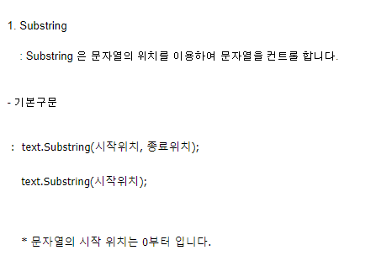
Substring()

Slide 4
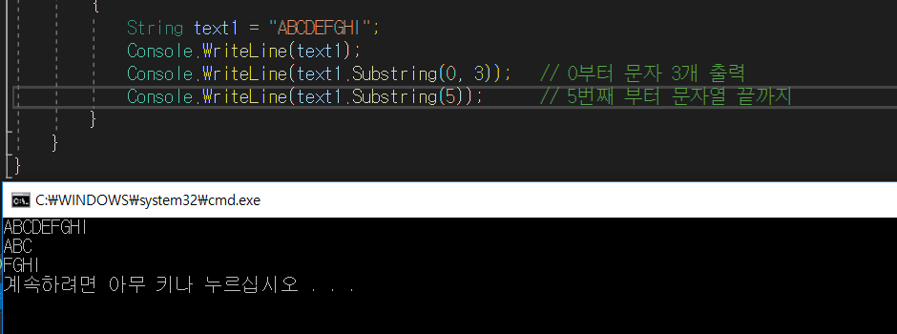
Substring()

Slide 5
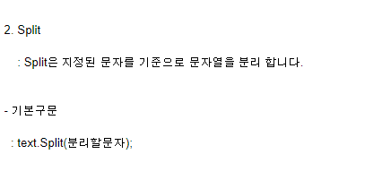
Split()

Slide 6
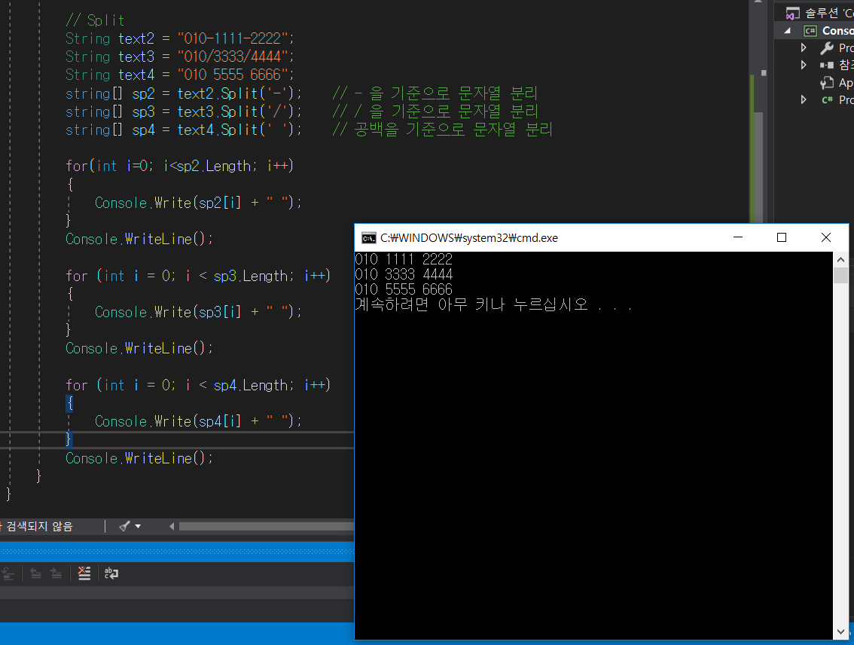
Split()

Slide 7
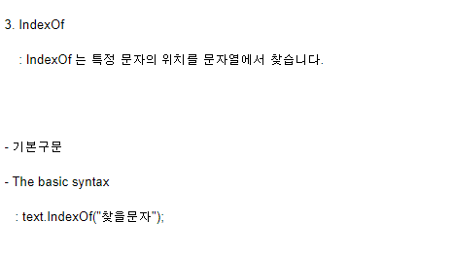
IndexOf()

Slide 8
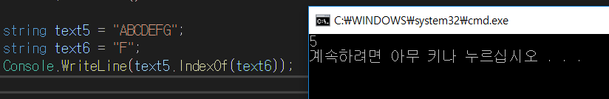
IndexOf()

Slide 9
ToString()

Slide 10

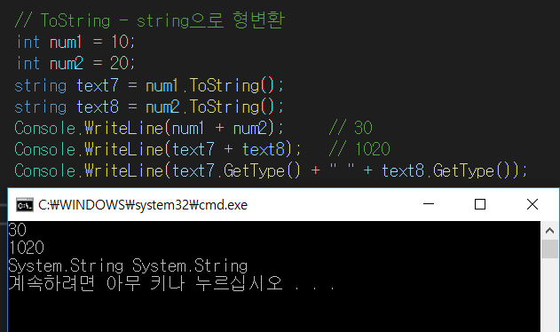
ToString()

Slide 11

int.Parse()

Slide 12
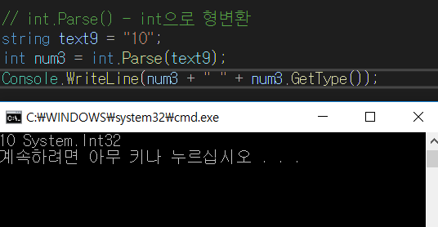
int.Parse()

Slide 13

Replace()

Slide 14
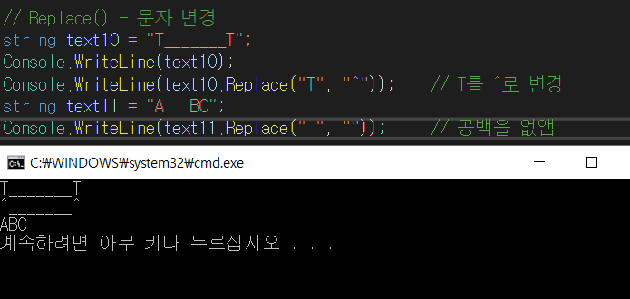
Replace()

Slide 15
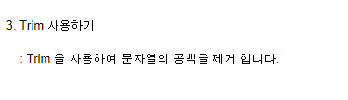
Trim()

Slide 16
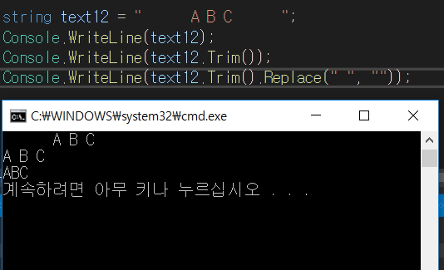
Trim()

Slide 17
Q & A
QnA

